Slide 1
Unit 5 GUI PROGRAMMING AND DATABASE CONNECTIVITY

Slide 2
Introduction to tkinter
Tkinter is the standard GUI library for Python.
Tkinter provides a fast and easy way to create GUI applications.
Tkinter provides a powerful object-oriented interface to the Tk GUI toolkit.
Steps −
Import the Tkinter module.
Create the GUI application main window.
Add one or more of the above-mentioned widgets to the GUI application.
Enter the main event loop to take action against each event triggered by the user.

Slide 3
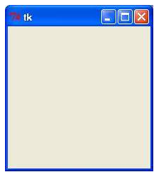
Example…..
#!/usr/bin/python
import tkinter
top = tkinter.Tk()
# Code to add widgets will go here...
top.mainloop()

Slide 4
Tkinter Widgets
Tkinter provides various controls, such as buttons, labels and text boxes used in a GUI application. These controls are commonly called widgets.
There are currently 15 types of widgets in Tkinter.

Slide 5
1. Button
used to display buttons in your application.
syntax:
w = Button ( master, option=value, ... )
Parameters
master: This represents the parent window.
options: Here is the list of most commonly used options for this widget.
Notes:
Method
flash()
Invoke()

Slide 6
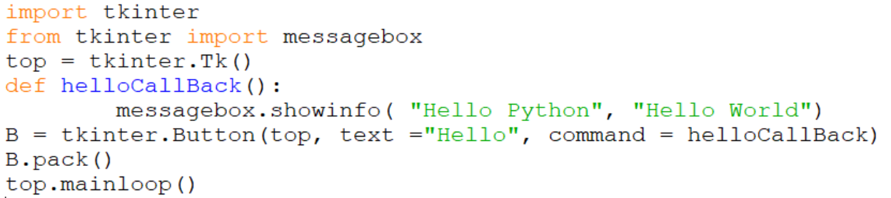
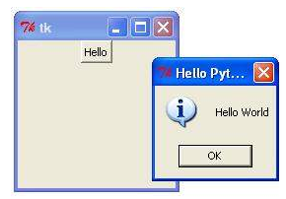
1. Button(cont)

Slide 7
Button Event Handling
from tkinter import *
def hello(event):
print("Single Click, Button-l")
def quit(event):
print("Double Click, so let's stop")
import sys; sys.exit()
widget = Button(None, text='Mouse Clicks')
widget.pack()
widget.bind('<Button-1>', hello)
widget.bind('<Double-1>', quit)
widget.mainloop()

Slide 8
2. Entry
The Entry widget is used to accept single-line text strings from a user.
If you want to display multiple lines of text that can be edited, then you should use the Text widget.
If you want to display one or more lines of text that cannot be modified by the user, then you should use the Label widget.
Syntax
w = Entry( master, option, ... )

Slide 9
2. Entry
Method Description
delete ( first, last=None ) Deletes characters from the widget, starting with the one at index first, up to but not including the character at position last. If the second argument is omitted, only the single character at position first is deleted.
get() Returns the entry's current text as a string.
icursor ( index ) Set the insertion cursor just before the character at he given index.
index ( index ) Shift the contents of the entry so that the character at the given index is the leftmost visible character. Has no effect if the text fits entirely within the entry.
insert ( index, s ) Inserts string s before the character at the given index.
select_adjust ( index ) This method is used to make sure that the selection includes the character at the specified index.

Slide 10
2. Entry
select_clear() Clears the selection. If there isn't currently a selection, has no effect.
select_from ( index ) Sets the ANCHOR index position to the character selected by index, and selects that character.
select_present() If there is a selection, returns true, else returns false.
select_range ( start, end ) Sets the selection under program control. Selects the text starting at the start index, up to but not including the character at the end index. The start position must be before the end position.
select_to ( index ) Selects all the text from the ANCHOR position up to but not including the character at the given
index.xview ( index ) This method is useful in linking the Entry widget to a horizontal scrollbar.
xview_scroll ( number, what )Used to scroll the entry horizontally. The what argument must be either UNITS, to scroll by character widths, or PAGES, to scroll by chunks the size of the entry widget. The number is positive to scroll left to right, negative to scroll right to left.

Slide 11

2. Entry
from tkinter import *
top = Tk()
L1 = Label(top, text="User Name")
L1.pack( side = LEFT)
E1 = Entry(top, bd =5)
E1.pack(side = RIGHT)
top.mainloop()

Slide 12
Frame
The Frame widget is very important for the process of grouping and organizing other widgets in a somehow friendly way.
It works like a container, which is responsible for arranging the position of other widgets.
A frame can also be used as a foundation class to implement complex widgets.
Syntax
w = Frame ( master, option, ... )Parameters
master: This represents the parent window.
options: Here is the list of most commonly used options for this widget.

Slide 13

Frame
from Tkinter import *
root = Tk()
frame = Frame(root)
frame.pack()
bottomframe = Frame(root)
bottomframe.pack( side = BOTTOM )
redbutton = Button(frame, text="Red", fg="red")
redbutton.pack( side = LEFT)
greenbutton = Button(frame, text="Brown", fg="brown")
greenbutton.pack( side = LEFT )
bluebutton = Button(frame, text="Blue", fg="blue")
bluebutton.pack( side = LEFT )
blackbutton = Button(bottomframe, text="Black", fg="black")
blackbutton.pack( side = BOTTOM)
root.mainloop()

Slide 14
Label
This widget implements a display box where you can place text or images.
The text displayed by this widget can be updated at any time you want.
It is also possible to underline part of the text (like to identify a keyboard shortcut) and span the text across multiple lines.
Syntax
w = Label ( master, option, ... )Parameters:
master: This represents the parent window.
options: Here is the list of most commonly used options for this widget.

Slide 15

Label
from Tkinter import *
root = Tk()
var = StringVar()
label = Label( root, textvariable=var, relief=RAISED )
var.set("Hey!? How are you doing?")
label.pack()
root.mainloop()

Slide 16
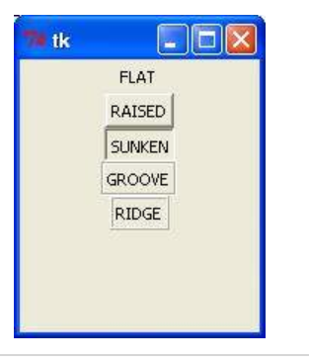
relief attribute styles

Slide 17
3.Listbox
The Listbox widget is used to display a list of items from which a user can select a number of items
Syntax
w = Listbox ( master, option, ... )Parameters
master: This represents the parent window.
options: Here is the list of most commonly used options for this widget.

Slide 18
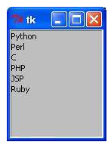
3.Listbox
import tkinter
top = Tk()
Lb1 = Listbox(top)
Lb1.insert(1, "Python")
Lb1.insert(2, "Perl")
Lb1.insert(3, "C")
Lb1.insert(4, "PHP")
Lb1.insert(5, "JSP")
Lb1.insert(6, "Ruby") Lb1.pack()
top.mainloop()

Slide 19
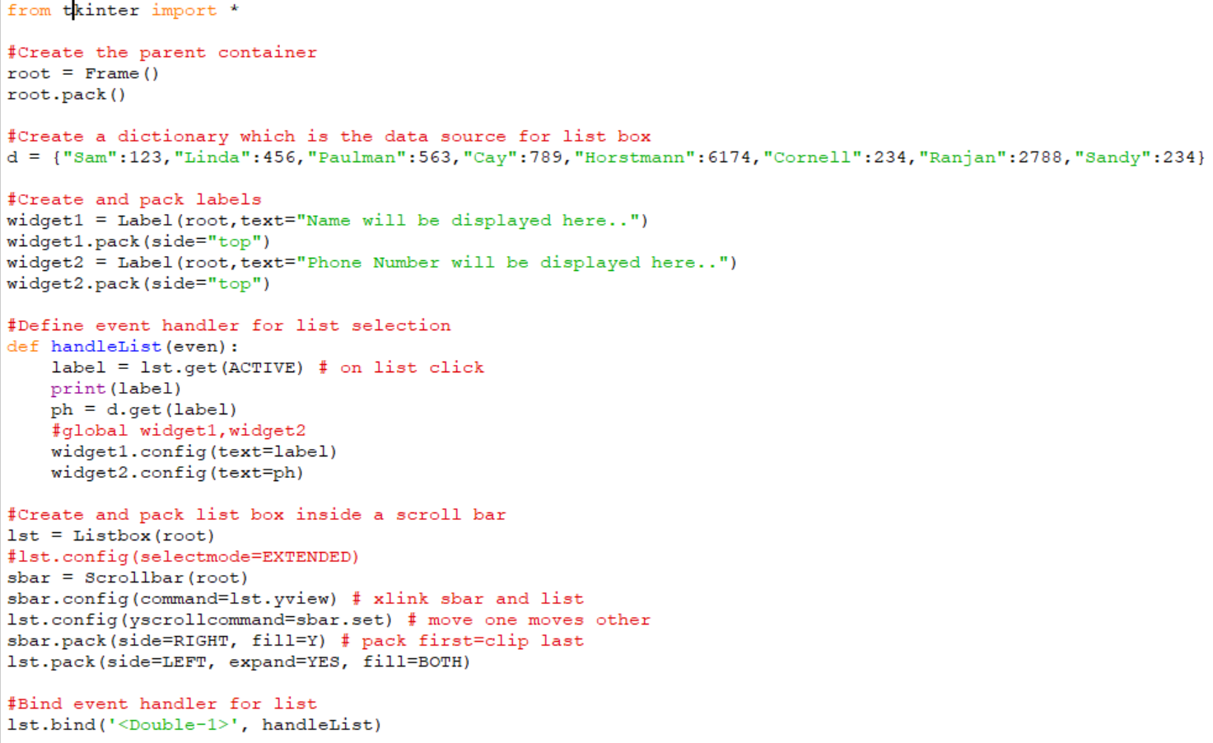
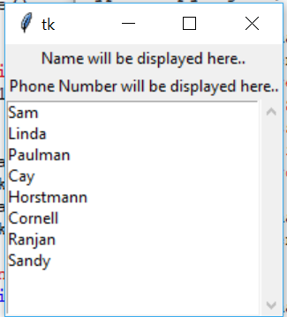
3.Listbox Event Handling

Slide 20
4. MenuBars and MenuButtons
Menubar
Add menubar to the root
Add menus to the menubar using add_cascade
Add choices under each menu using add_command
MenuButton
Create a menubutton object
Create a menu object
Bind menu to menubutton
Add choices under menu

Slide 21
4.Menubutton
A menubutton is the part of a drop-down menu that stays on the screen all the time.
Every menubutton is associated with a Menu widget that can display the choices for that menubutton when the user clicks on it.
Syntax
w = Menubutton ( master, option, ... )Parameters
master: This represents the parent window.
options: Here is the list of most commonly used options for this widget.

Slide 22
4.Menubutton
from tkinter import *
top = Tk()
mb= Menubutton ( top, text="condiments", relief=RAISED )
choices = Menu ( mb)
mb.config(menu=choices)
choices.add_command(label=“Python”,command = top.quit)
choices.add_command(label=“Java”,command = top.quit)
choices.add_command(label=“Haskell”,command = top.quit)
mb.pack()
top.mainloop()

Slide 23
4. Menu
It allow us to create all kinds of menus that can be used by our applications.
The core functionality provides ways to create three menu types: pop-up, toplevel and pull-down.
It is also possible to use other extended widgets to implement new types of menus, such as the OptionMenu widget, which implements a special type that generates a pop-up list of items within a selection.
Syntax
w = Menu ( master, option, ... )

Slide 24
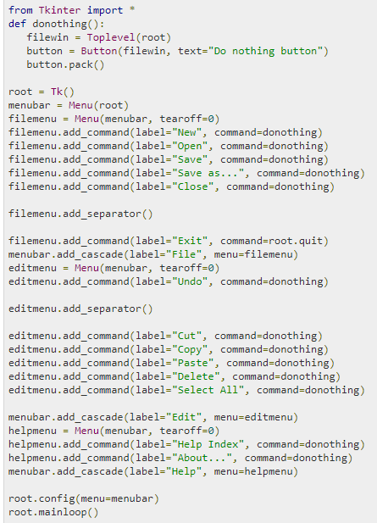
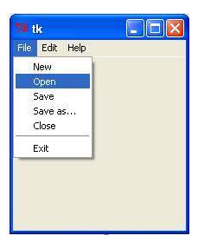

Slide 25
5. Message
This widget provides a multiline and noneditable object that displays texts, automatically breaking lines and justifying their contents.
Its functionality is very similar to the one provided by the Label widget, except that it can also automatically wrap the text, maintaining a given width or aspect ratio.
Syntax
w = Message ( master, option, ... )

Slide 26
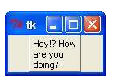
5. Message
from tkinter import *
root = Tk()
var = StringVar()
label = Message( root, textvariable=var, relief=RAISED )
var.set("Hey!? How are you doing?")
label.pack()
root.mainloop()

Slide 27
6. Text
Text widgets provide advanced capabilities that allow you to edit a multiline text and format the way it has to be displayed, such as changing its color and font.
Syntax
w = Text ( master, option, ... )
Methods
delete(startindex[,endindex])
This method deletes a specific character or a range of text.
get(startindex [,endindex]) This method returns a specific character or a range of text.
index(index) Returns the absolute value of an index based on the given index.
insert(index [,string]...) This method inserts strings at the specified index location.
see(index) This method returns true if the text located at the index position is visible.

Slide 28
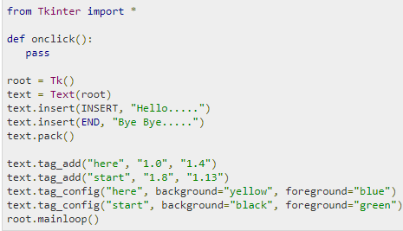
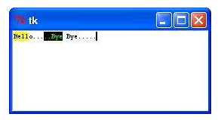
6. Text

Slide 29
7. Scrollbar
This widget provides a slide controller that is used to implement vertical scrolled widgets, such as Listbox, Text and Canvas.
Note that you can also create horizontal scrollbars on Entry widgets.
Syntax
w = Scrollbar ( master, option, ... )
Methods
get()
Returns two numbers (a, b) describing the current position of the slider. The a value gives the position of the left or top edge of the slider, for horizontal and vertical scrollbars respectively; the b value gives the position of the right or bottom edge.
set ( first, last )
To connect a scrollbar to another widget w, set w's xscrollcommand or yscrollcommand to the scrollbar's set() method. The arguments have the same meaning as the values returned by the get() method.

Slide 30
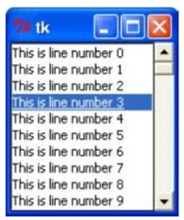
7. Scrollbar
from Tkinter import *
root = Tk()
scrollbar = Scrollbar(root)
scrollbar.pack( side = RIGHT, fill=Y )
mylist = Listbox(root, yscrollcommand = scrollbar.set )
for line in range(100):
mylist.insert(END, "This is line number " + str(line))
mylist.pack( side = LEFT, fill = BOTH )
scrollbar.config( command = mylist.yview )
mainloop()

Slide 31
Geometry Management
The pack() Method - This geometry manager organizes widgets in blocks before placing them in the parent widget.
The grid() Method - This geometry manager organizes widgets in a table-like structure in the parent widget.
The place() Method -This geometry manager organizes widgets by placing them in a specific position in the parent widget.

Slide 32
Top level window
tk_chooseColor - pops up a dialog box for the user to select a color.
tk_chooseDirectory - pops up a dialog box for the user to select a directory.
tk_dialog - creates a modal dialog and waits for a response.
tk_getOpenFile - pops up a dialog box for the user to select a file to open.
tk_getSaveFile - pops up a dialog box for the user to select a file to save.
tk_messageBox - pops up a message window and waits for a user response.
tk_popup - posts a popup menu.
toplevel - creates and manipulates toplevel widgets.

Slide 33
Dialogs
Used to display message boxes, and to select files and colors.
It also allow you to ask the user for integers, floating point values, and strings.
Standard dialogs use platform-specific mechanisms, to get the right look and feel.

Slide 34
Message Dialogs
The messagebox module provides an interface to the message dialogs.
Functions:
showinfo
showwarning
showerror
Askquestion
Askokcancel
askyesno, or askretrycancel.
Syntax :
messagebox.function(title, message [, options]).
FunctionName: name of the appropriate message box function.
title: text to be displayed in the title bar of a message box.
message: text to be displayed as a message.
options: options are alternative choices that you may use to tailor a standard message box.
Some of the options that you can use are default and parent. T
he default option is used to specify the default button, such as ABORT, RETRY, or IGNORE in the message box.
The parent option is used to specify the window on top of which the message box is to be displayed.

Slide 35
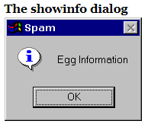
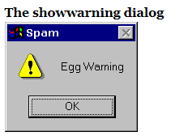
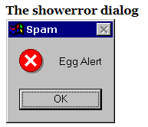
Message Dialogs
try:
fp = open(filename)
except:
messagexox.showwarning( "Open file", "Cannot open this file\n(%s)" % filename ) return

Slide 36
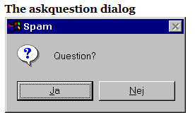
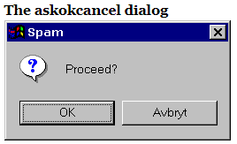
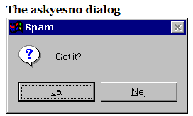
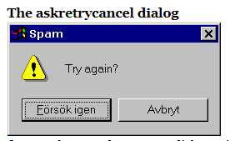
Message Dialogs
The askquestion function returns the strings “yes” or “no”,
if tkMessageBox.askyesno("Print", "Print this report?"):
report.print()

Slide 37
Message Box Options
If the standard message boxes are not appropriate, you can pick the closest alternative (askquestion, in most cases), and use options to change it to exactly suit your needs.
default constant
Which button to make default: ABORT, RETRY, IGNORE, OK, CANCEL, YES, or NO (the constants are defined in the tkMessageBox module).
icon (constant)
Which icon to display: ERROR, INFO, QUESTION, or WARNING
message (string)
The message to display (the second argument to the convenience functions). May contain newlines.
parent (widget)
Which window to place the message box on top of. When the message box is closed, the focus is returned to the parent window.
title (string)
Message box title (the first argument to the convenience functions).
type (constant)
Message box type; that is, which buttons to display: ABORTRETRYIGNORE, OK, OKCANCEL, RETRYCANCEL, YESNO, or YESNOCANCEL.

Slide 38
SQL Database interfaces with sqlite3: Basic operations table load scripts
Session 5

Slide 39
SQL Database interfaces with sqlite3
SQLite is a C library that provides a lightweight disk-based database that doesn’t require a separate server process and allows accessing the database using a nonstandard variant of the SQL query language.
Some applications can use SQLite for internal data storage.
It’s also possible to prototype an application using SQLite and then port the code to a larger database such as PostgreSQL or Oracle.
The sqlite3 module was written by Gerhard Häring.
It provides a SQL interface compliant with the DB-API 2.0 specification described by PEP 249
To use the module, you must first create a Connection object that represents the database. Here the data will be stored in the example.db file:
import sqlite3 conn = sqlite3.connect('example.db')

Slide 40
Python sqlite3 module APIs
sqlite3.connect(database [,timeout ,other optional arguments])
This API opens a connection to the SQLite database file. You can use ":memory:" to open a database connection to a database that resides in RAM instead of on disk. If database is opened successfully, it returns a connection object.
When a database is accessed by multiple connections, and one of the processes modifies the database, the SQLite database is locked until that transaction is committed. The timeout parameter specifies how long the connection should wait for the lock to go away until raising an exception. The default for the timeout parameter is 5.0 (five seconds).
If the given database name does not exist then this call will create the database. You can specify filename with the required path as well if you want to create a database anywhere else except in the current directory.
connection.cursor([cursorClass])
This routine creates a cursor which will be used throughout of your database programming with Python.
This method accepts a single optional parameter cursorClass.
If supplied, this must be a custom cursor class that extends sqlite3.Cursor.

Slide 41
Python sqlite3 module APIs
cursor.execute(sql [, optional parameters])
This routine executes an SQL statement. The SQL statement may be parameterized (i. e. placeholders instead of SQL literals). The sqlite3 module supports two kinds of placeholders: question marks and named placeholders (named style).
For example − cursor.execute("insert into people values (?, ?)", (who, age))
connection.execute(sql [, optional parameters])
This routine is a shortcut of the above execute method provided by the cursor object and it creates an intermediate cursor object by calling the cursor method, then calls the cursor's execute method with the parameters given.
cursor.executemany(sql, seq_of_parameters)
This routine executes an SQL command against all parameter sequences or mappings found in the sequence sql.
connection.executemany(sql[, parameters])
This routine is a shortcut that creates an intermediate cursor object by calling the cursor method, then calls the cursor.s executemany method with the parameters given.
cursor.executescript(sql_script)
This routine executes multiple SQL statements at once provided in the form of script. It issues a COMMIT statement first, then executes the SQL script it gets as a parameter. All the SQL statements should be separated by a semi colon (;).
connection.executescript(sql_script)
This routine is a shortcut that creates an intermediate cursor object by calling the cursor method, then calls the cursor's executescript method with the parameters given.

Slide 42
Python sqlite3 module APIs
connection.total_changes()
This routine returns the total number of database rows that have been modified, inserted, or deleted since the database connection was opened.
connection.commit()
This method commits the current transaction. If you don't call this method, anything you did since the last call to commit() is not visible from other database connections.
connection.rollback()
This method rolls back any changes to the database since the last call to commit().
connection.close()
This method closes the database connection. Note that this does not automatically call commit(). If you just close your database connection without calling commit() first, your changes will be lost!
cursor.fetchone()
This method fetches the next row of a query result set, returning a single sequence, or None when no more data is available.
cursor.fetchmany([size = cursor.arraysize])
This routine fetches the next set of rows of a query result, returning a list. An empty list is returned when no more rows are available. The method tries to fetch as many rows as indicated by the size parameter.
cursor.fetchall()
This routine fetches all (remaining) rows of a query result, returning a list. An empty list is returned when no rows are available.

Slide 43
Connect To Database
to connect to an existing database. If the database does not exist, then it will be created and finally a database object will be returned.
import sqlite3
conn = sqlite3.connect('test.db')
print "Opened database successfully";
Here, you can also supply database name as the special name :memory: to create a database in RAM.
Now, let's run the above program to create our database test.db in the current directory.
You can change your path as per your requirement.
Keep the above code in sqlite.py file and execute it as shown below. If the database is successfully created, then it will display the following message.
$chmod +x sqlite.py
$./sqlite.py
Open database successfully

Slide 44
Create a Table
import sqlite3
conn = sqlite3.connect('test.db')
print "Opened database successfully";
conn.execute('''CREATE TABLE COMPANY (ID INT PRIMARY KEY NOT NULL, NAME TEXT NOT NULL, AGE INT NOT NULL, ADDRESS CHAR(50), SALARY REAL);''')
print "Table created successfully";
conn.close()

Slide 45
INSERT Operation
import sqlite3
conn = sqlite3.connect('test.db')
print "Opened database successfully";
conn.execute("INSERT INTO COMPANY (ID,NAME,AGE,ADDRESS,SALARY) \ VALUES (1, 'Paul', 32, 'California', 20000.00 )");
conn.execute("INSERT INTO COMPANY (ID,NAME,AGE,ADDRESS,SALARY) \ VALUES (2, 'Allen', 25, 'Texas', 15000.00 )");
conn.execute("INSERT INTO COMPANY (ID,NAME,AGE,ADDRESS,SALARY) \ VALUES (3, 'Teddy', 23, 'Norway', 20000.00 )");
conn.execute("INSERT INTO COMPANY (ID,NAME,AGE,ADDRESS,SALARY) \ VALUES (4, 'Mark', 25, 'Rich-Mond ', 65000.00 )");
conn.commit()
print "Records created successfully";
conn.close()

Slide 46
SELECT Operation
import sqlite3
conn = sqlite3.connect('test.db')
print "Opened database successfully";
cursor = conn.execute("SELECT id, name, address, salary from COMPANY")
for row in cursor:
print "ID = ", row[0]
print "NAME = ", row[1]
print "ADDRESS = ", row[2]
print "SALARY = ", row[3], "\n"
print "Operation done successfully";
conn.close()

Slide 47
UPDATE Operation
import sqlite3
conn = sqlite3.connect('test.db')
print "Opened database successfully";
conn.execute("UPDATE COMPANY set SALARY = 25000.00 where ID = 1")
conn.commit
print "Total number of rows updated :",
conn.total_changes
cursor = conn.execute("SELECT id, name, address, salary from COMPANY")
for row in cursor:
print "ID = ", row[0]
print "NAME = ", row[1]
print "ADDRESS = ", row[2]
print "SALARY = ", row[3], "\n"
print "Operation done successfully";
conn.close()

Slide 48
DELETE Operation
import sqlite3
conn = sqlite3.connect('test.db')
print "Opened database successfully";
conn.execute("DELETE from COMPANY where ID = 2;")
conn.commit()
print "Total number of rows deleted :",
conn.total_changes
cursor = conn.execute("SELECT id, name, address, salary from COMPANY")
for row in cursor:
print "ID = ", row[0]
print "NAME = ", row[1]
print "ADDRESS = ", row[2]
print "SALARY = ", row[3], "\n"
print "Operation done successfully";
conn.close()

Slide 49
Table load scripts
Session 6

Slide 50
Loading DB tables from files
Loading with SQL and python
data.txt data2.txt
bob,devel,50000 bob,developer,80000
sue,music,60000 sue,music,90000
ann,devel,40000 ann,manager,80000
Tim, admin,30000
Kim,devel,60000

Slide 51
Loading DB tables from files
# Using MySQL (currently available for Python 2.X only)
...log into MySQL first...
>>> curs.execute('delete from people') # all records
>>> curs.execute(
... "load data local infile 'data.txt' "
... "into table people fields terminated by ','")
>>> curs.execute('select * from people')
>>> for row in curs.fetchall(): print(row)
...
('bob', 'devel', 50000L)
('sue', 'music', 60000L) # 2.X long integers
('ann', 'devel', 40000L)
('tim', 'admin', 30000L)
('kim', 'devel', 60000L)
>>> conn.commit()

Slide 52
Loading DB tables from files
C:\...\PP4E\Dbase\Sql> python
>>> from sqlite3 import connect
>>> conn = connect('dbase1')
>>> curs = conn.cursor()
>>> curs.execute('delete from people') # empty the table
>>> curs.execute('select * from people')
>>> curs.fetchall()
[]

Slide 53
Loading DB tables from files
>>> file = open('data.txt')
>>> rows = [line.rstrip().split(',') for line in file]
>>> rows[0]
['bob', 'devel', '50000']
>>> for rec in rows:
.... curs.execute('insert into people values (?, ?, ?)', rec)
...
>>> curs.execute('select * from people')
>>> for rec in curs.fetchall(): print(rec)
...
('bob', 'devel', 50000)
('sue', 'music', 60000)
('ann', 'devel', 40000)
('tim', 'admin', 30000)
('kim', 'devel', 60000)

Slide 54
Python versus SQL
>>> curs.execute("select sum(pay), avg(pay) from people where job = 'devel'")
>>> curs.fetchall()
[(150000, 50000.0)]
>>> curs.execute("select name, pay from people where job = 'devel'")
>>> result = curs.fetchall()
>>> result
(('bob', 50000L), ('ann', 40000L), ('kim', 60000L))

Slide 55
Python versus SQL
>>> tot = 0
>>> for (name, pay) in result: tot += pay
...
>>> print('total:', tot, 'average:', tot / len(result)) # use // to truncate
total: 150000 average: 50000.0
>>> print(sum(rec[1] for rec in result)) # generator expr
150000
>>> print(sum(rec[1] for rec in result) / len(result))
50000.0
>>> print(max(rec[1] for rec in result))
60000
>>> avg = sum(rec[1] for rec in result) / len(result)
>>> print([rec[0] for rec in result if rec[1] > avg])
['kim']
>>> print([rec[0] for rec in result if rec[1] < avg])
['ann']

Slide 56
Python versus SQL
>>> query = ("select name from people where job = 'devel' and "
... "pay > (select avg(pay) from people where job = 'devel')")
>>> curs.execute(query)
>>> curs.fetchall()
[('kim',)]
>>> query = ("select name from people where job = 'devel' and "
... "pay < (select avg(pay) from people where job = 'devel')")
>>> curs.execute(query)
>>> curs.fetchall()
[('ann',)]

Slide 57
Python versus SQL
>>> from makedicts import makedicts
>>> recs = makedicts(curs, "select * from people where job = 'devel'")
>>> print(len(recs), recs[0])
3 {'pay': 50000, 'job': 'devel', 'name': 'bob'}
>>> print([rec['name'] for rec in recs])
['bob', 'ann', 'kim']
>>> print(sum(rec['pay'] for rec in recs))
150000
>>> avg = sum(rec['pay'] for rec in recs) / len(recs)
>>> print([rec['name'] for rec in recs if rec['pay'] > avg])
['kim']
>>> print([rec['name'] for rec in recs if rec['pay'] >= avg])
['bob', 'kim']

